Slide 1
Introduction To optimization
11.05.2021
Andrian Gasper

Slide 2
What Type of analytics is optimization? *And how is it different?
What should we do?
Optimization
Structural Models
Programming/Heuristics
Machine Learning
Prescriptive?
What’s going to happen?
Machine Learning
Simulations
Predictive Models
Predictive?
What’s going on?
Regressions
Econometrics
A/B testing
Summary Statistics
Dashboards
Descriptive and Diagnostic?

Slide 3
What exactly is Optimization?
Inputs
Outputs
Best Y
Y
Best X
X

Slide 4
Describing Optimization models
MAXIMIZE
LIMITS
(Constraints)
MINIMIZE

Slide 5



Describing Optimization models
(Model Elements)
Optimization model consists of:
(3,4)
Given data. Constants. Data that does not change during the optimization calculations.
Parameters
Decision Variables
$${(X}_{1},X_{2})$$
Values/Variables the optimizer can change.
(A) and (B) are combined to formulate:
Max: f(x) $={3X}_{1}+{4X}_{2}$
The value/function one wants to optimize.
Objective Function
$X_{1}+X_{2}$ < 10
Where the optimizer cannot go. Conditions that must be met for a successful solution.
2. Constraints

Slide 6
Examples of objective functions
SPEED
PROFIT
CLICKS
COST
WASTE

Slide 7
Examples of Constraints
- A chemical mixture must be at least 99% pure.
- Inventory level cannot exceed 50 tons.
Best Y
Y
- A bridge must hold at least 150 tons.
- At least x amount of demand must be satisfied.
Best X
X
- No more than y amount of money can be invested.

Slide 8
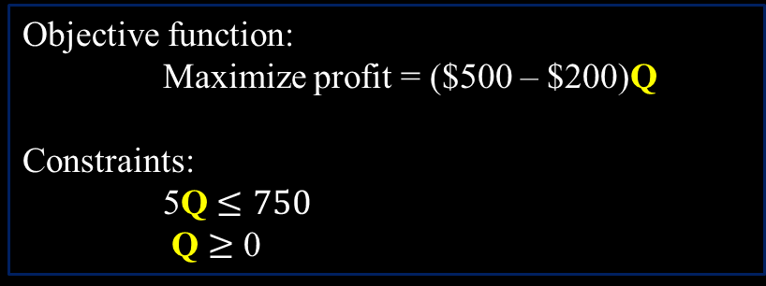
Simple Optimization Problem (Example 1)
One variable
Parameters:
Sales Price $500
Cost Per Unit $200
Hours Per Unit 5 hr.
Capacity 750 hr.
Decision Variables:
Production Quantity “Q”
Objective function:
Maximize profit = ($500 – $200)Q
Constraints:
5Q $≤750$
Q $≥$ 0
The optimal solution is easy to find because there is only one variable
Produce as much as possible of Q
Q = 750 / 5 = 150 units.
Total profit = $300 × 150 = $45,000

Slide 9



Simple Optimization Problem (Example 2)
Multiple variables
Parameters:
Sales Price $p_{i}$
Cost Per Unit $c_{i}$
Hours Per Unit $a_{i}$
Capacity $b$
Maximum Sale $m_{i}$
Decision Variables:
Production Quantity “$Q_{i}$”
Objective function:
Maximize profit = $\sum_{i}{(p_{i}−c_{i})Q_{i}}$
Constraints:
$\sum_{i}{a_{i}Q_{i}≤b}$
$Q_{i}≤m_{i} for all "i"$
$Q_{i}≥0 for all "i"$
$$i ε \{1 to NumberOfProducts\}$$

Slide 10


Classification of optimization models
LP (Linear Programming)
MILP(Mixed-Integer Linear Programing)
NLP (Non-Linear Programming)
MINLP(Mixed-Integer Non-Linear Programming)
All decision variables are “continuous”. Both the objective function and the constraints represent linear relationships, meaning that decision variables do not multiply or divide between each over under any form (at the power of, absolute value, square root etc.).
$$max:aX+bY$$
Similar to Linear Programming but contains at least one “binary” and/or “integer” decision variable. Integer$ε Z(…−1,0,1,2,3…),$ Binary $ε \left(0,1\right).$
All decision variables are “continuous”. At least the objective function or one of the constraints represents a non-linear relationship, meaning that decision variables multiply or divide between each over under any form (at the power of, absolute value, square root etc.).
$$max:aX^{2}Y −b$$
Similar to Non-Linear Programming but contains at least one “binary” and/or “integer” decision variable.
Note: The word “Programming” here can be replaced with “Optimization”, for example: “Linear Optimization”

Slide 11
Solving Complexity
MINLP
MILP
Time to solve
(computational complexity)
NLP
LP
# real world problems that can be modeled

Slide 12
Solving optimization models
Solvers:
Gurobi
CPLEX
BARON
FICO Xpress
LINDO
Coin-or (CBC)
SCIP
GLPK
Glop
lp_solve
Availability
Commercial
Commercial
Commercial
Commercial
Commercial
Free
Free
Free
Free
Free
Problems they can solve:
LP/MILP/(Quadratic Obj. function)
LP/MILP/(Quadratic Obj. function)
LP/MILP/NLP/MINLP
LP/MILP/NLP/MINLP
LP/MILP/NLP/MINLP
LP/MILP/NLP/MINLP
LP/MILP/NLP/MINLP
LP/MILP
LP
LP/MILP
NP-Hard problems are very difficult to solve. (ex. Traveling-salesman)

Slide 13
Some Applications
Choosing the optimal location for a warehouse to minimize shipment time to potential customers.
Controlling the insulin output from an artificial pancreas to minimize the difference between the actual and desired blood sugar level throughout the day.
Designing an airplane wing, to minimize weight while maintaining strength.
Selecting the best set of stocks to invest in to maximize returns based on predicted performance.
Setting the correct asset price at different time periods, based on estimated demand function, in order to maximize profit.
Distributing marketing investments to different media channels to maximize view per NOK, based on channels reach and costs.
Plan the optimal distribution schedule to different selling locations, to minimizing the cost while satisfying estimated demand.
Often, optimization problems that involve economical objectives or constraints, require stochastic/uncertain estimates or assumptions to show how the inputs can affects the outputs. Such as: risk/return, predicted demand, probabilities, coefficients of influence (regressions) etc.

Slide 14
Steps for building an optimization model
Decide on the business problem you are trying to model.
Determine the inputs and outputs of the model. Moreover, determine (logically) how do the inputs affect the outputs?
Decide on limitations this problem involves.
Model mathematically a simplified version of this process/problem.
Get the necessary information/data if possible otherwise return to step 2.
Solve and check the results.
Improve the model if possible and return to step 6.

Slide 15


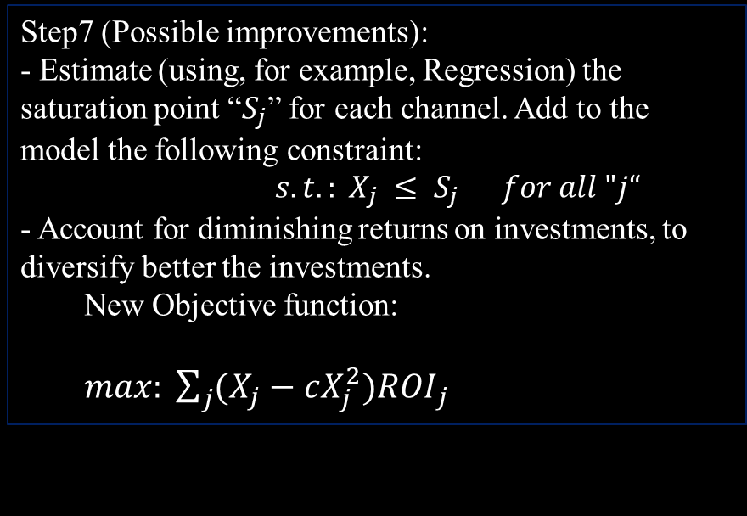


Simple example of the use of optimization in marketing
Step1 (The problem):
-Allocate the marketing budget in the best way to different marketing channels (FB, TV, Instagram)
Step2 (Input-Output):
-Input = amount invested in each channel.
-Output = maximum total income
-The input affects the output through the ROI of each channel.
Step6:
- Write the model in a computer program (ex: Python).
- Use a solver to solve the model.
- Analyze the results.
Step3 (Limitations):
-The budget “B”
-TV investments should not exceed 50% of the total investments.”
Step7 (Possible improvements):
- Estimate (using, for example, Regression) the saturation point “$S_{j}$” for each channel. Add to the model the following constraint:
$s.t.: X_{j} ≤ S_{j} for all "j“$
- Account for diminishing returns on investments, to diversify better the investments.
New Objective function:
$max: \sum_{j}{(X_{j}{− cX_{j}^{2})ROI}_{j}}$
Step4 (Simplified Model):
$$max: \sum_{j}{X_{j}{ROI}_{j}}$$
Parameters
Decision Variable
$$s.t.: \sum_{j}{X_{j} ≤B}$$
$$s.t.: X_{TV} ≤0.5\sum_{j}{X_{j}}$$
Step5 (Get Data):
- Ask manager for the budget limit
- Estimate ${ROI}_{j}$ using a (for example) multi/last-tough attribute model.
Non-Linear
Note: The NEW objective function will not tell as the total income anymore.

Slide 16
The END

